Slide 1
WG4: Ground support to space-weather missions
D.A. Biesecker (NOAA/SWPC) and KiChang Yoon (KSWC)

Slide 2
Overview
Ground data processing will be covered in the next talk
ESA ground station network in the subsequent talk
I’m only addressing what is used for existing RTSW or Beacon networks
Begin with a review of existing ‘operational’ (i.e. 24x7 networks)
ACE/DSCOVR - RTSW
STEREO
What is promised for the future
What is proposed for the future

Slide 3
Real-Time Solar Wind Network
Real-Time Solar Wind (RTSW) given that name by Zwickl et al. (1998)
Began in 1998 for the purpose of providing ACE data in real-time
ACE began the era of ‘space weather beacons’
RTSW now is used to reference any real-time, continuous solar wind data stream
Original partners were ISRO (India); RAL (UK); NICT (Japan); and NOAA (Boulder)
ISRO dropped out very early on
RAL replaced by Germany (DLR) in 2009
Korea (KSWC) added in 2012
Main issue with RTSW is it is a northern hemisphere network.

Slide 4
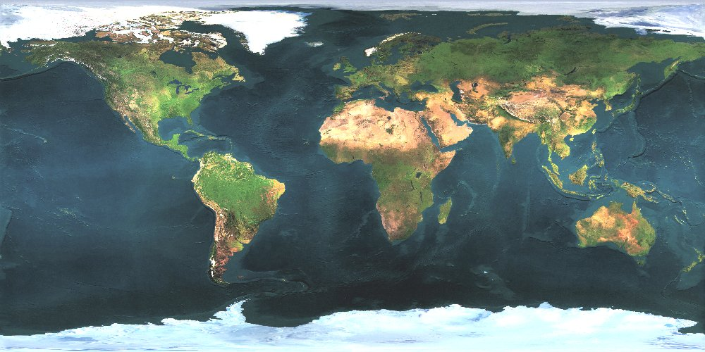
RTSWnet/NOAA
RTSWnet
NOAA
FCDAS (21m)
DLR (6m)
BLDR (6m)
NICT (11m)
WCDAS (18m)
KSWC (13m)

Slide 5
L1 Tracking
ACE
DSCOVR
S-band (2278 MHz)
434 bps
Range ~1.5E6 km
Convolutional coding
Rate=1/2
Reed-Solomon Error Correction
Dishes as small as 3m have been used
S-band (2215 MHz)
20 kbps (138 kbps high rate)
Range ~1.5E6 km
Convolutional coding
Rate = ½
Reed-Solomon Error Correction
Dishes of 6m have plenty of margin
In fact, Boulder’s 6m dish regularly receives the 138 kbps high rate

Slide 6
Current DSCOVR Tracking
Asia
National Institute of Information and Communications Technology (JAPAN)
Korean Space Weather Center
Europe
German Aerospace Center
Americas
NOAA Wallops Island VA
NOAA Boulder, CO
NOAA Fairbanks, AK
Johns Hopkins University Applied Physics Laboratory (as needed)
US Air Force provides tracking as needed.

Slide 7
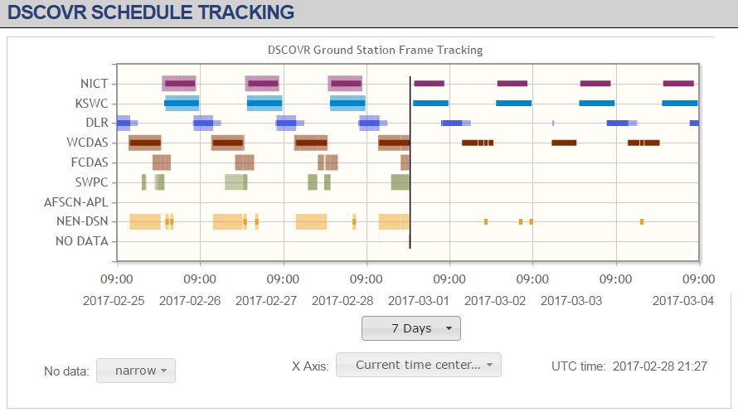
DSCOVR tracking

Slide 8
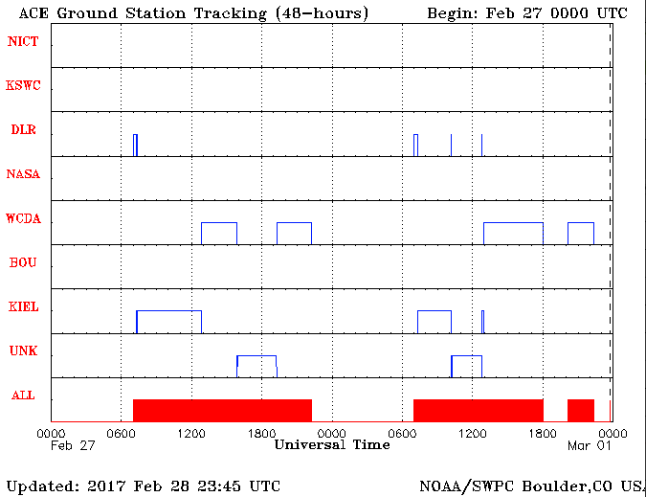
Current ACE tracking
DLR (German Aerospace)
Kiel (a STEREO tracking partner)
NOAA Wallops
NASA DSN
And all DSCOVR stations can track ACE if needed

Slide 9
STEREO Tracking
X-band (8443 MHz)
633 bps
Range ~1.3E8 km
Turbo* encoding
Rate=1/6
Reed-Solomon Error Correction
* Turbo was patented by France Telecom. Patents have expired. That means I deal with few lawyers than I used to.

Slide 10
Current STEREO Tracking
Asia
National Institute of Information and Communications Technology (JAPAN)
Korean Space Weather Center
Europe
AMSAT-DL (Bochum, Germany)
Centre National d’Etudes Spatiale (Toulouse, France)
DL0SHF (Kiel-Roenne, Germany)
Americas
Johns Hopkins University Applied Physics Laboratory (as needed)

Slide 11
STEREO Tracking Sites (Turbo)
Dedicated station
As available
BOCHUM (20m)
KIEL (9m)
NICT (11m)
CNES (9m)
JHU/APL (18m)
KSWC (13m)

Slide 12
Other relevant sites
25m dish in Raisting, Germany
Student run
NOAA funded SBIR to look at ground networks for future space weather needs (L1, L5)
Phase II of SBIR will investigate existing commercial station availability, capabilities, and costs.

Slide 13
Promised for L5
Well, ESA and UK Space will have to answer that question
KSWC, as they did for ACE and STEREO, stands ready to build an antenna that meets requirements

Slide 14
Possible for L5
Depending on the real-time data volume, lots
Borrow from STEREO?
NOAA?
Use SWAP 6.2.4
Letter from Volz (NESDIS AA) to Rolf Densing (ESA)
Potential partnership

Slide 15
SWAP Report Recommendations
Upgrades at Boulder
A new antenna to provide year-round coverage, even at higher bit rates. For long term considerations, we suggest this be something that could handle downlinks from spacecraft at L1 or L5. Preliminary estimates are that a dish of up to 15m might be required for L5.
SWPC received a quote for a 13m dish in 2014 for $1.01M
Two antennas would provide necessary redundancy
Upgrades at WCDAS
An additional antenna capable of uplink and downlink that can handle L1 and at least downlink of data from an L5 mission.
This would enable redundancy within WCDAS as well as provide potential support to an international L5 mission.
Upgrades at FCDAS
A new antenna capable of uplink and downlink that can handle L1 and at least downlink of data from an L5 mission. This would ensure that should WCDAS go down, both GOES and the L1 mission could be tracked from FCDAS.

